Slide 1
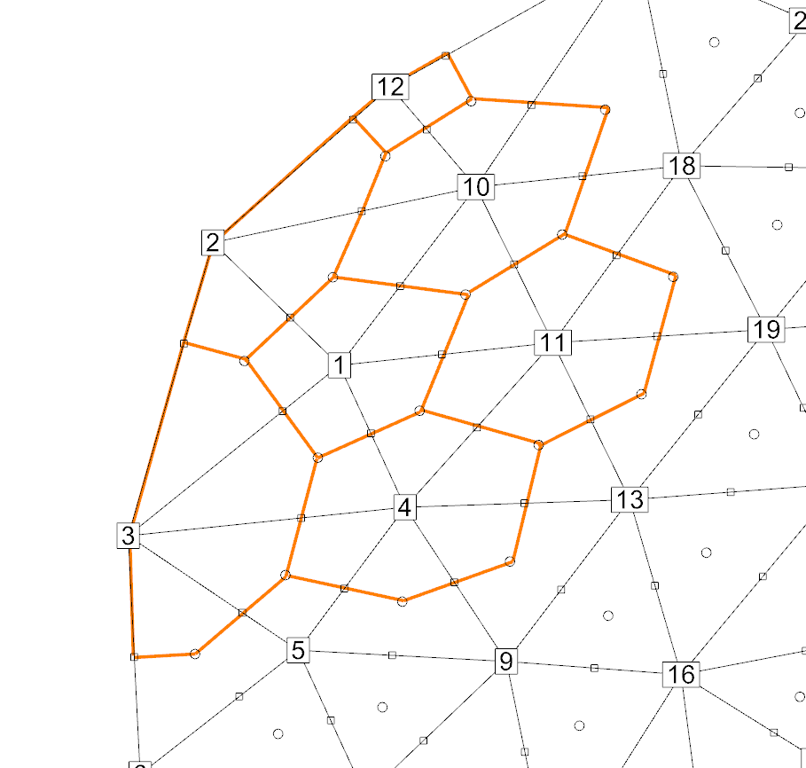

Slide 2
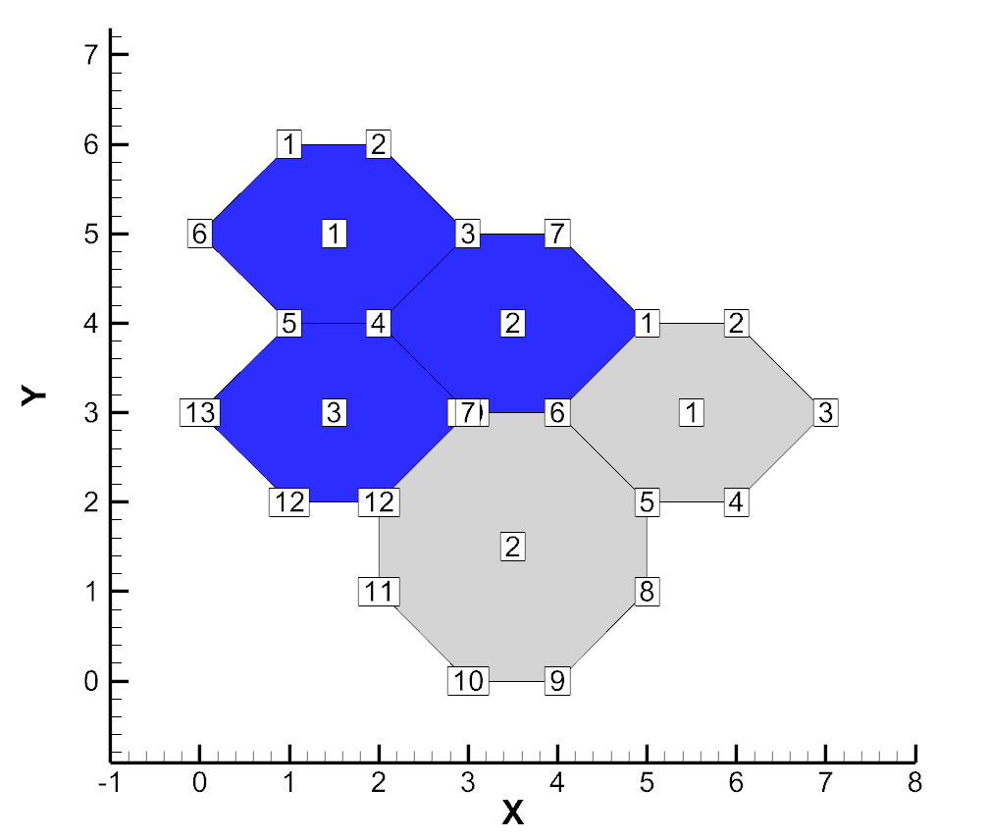
TITLE = "Example: Multiple polygonal zones"
VARIABLES = "X"
"Y"
"P"
ZONE T="Zone 1: 3 Hexagons"
STRANDID=0, SOLUTIONTIME=0
Nodes=13, Faces=15, Elements=3, ZONETYPE=FEPolygon
DATAPACKING=BLOCK
VARLOCATION=([3]=CELLCENTERED)
NumConnectedBoundaryFaces=3, TotalNumBoundaryConnections=3
DT=(SINGLE SINGLE SINGLE )
1.000000000E+000 2.000000000E+000 3.000000000E+000 2.000000000E+000 1.000000000E+000
0.000000000E+000 4.000000000E+000 5.000000000E+000 4.000000000E+000 3.000000000E+000
2.000000000E+000 1.000000000E+000 0.000000000E+000
6.000000000E+000 6.000000000E+000 5.000000000E+000 4.000000000E+000 4.000000000E+000
5.000000000E+000 5.000000000E+000 4.000000000E+000 3.000000000E+000 3.000000000E+000
2.000000000E+000 2.000000000E+000 3.000000000E+000
2.000000000E+000 4.000000000E+000 5.000000000E+000
# face nodes
1 2 2 3 3 4 4 5 5 6
6 1 3 7 7 8 8 9 9 10
10 4 10 11 11 12 12 13 13 5
# left elements
0 0 2 3 0 0 0 0 -1 -2
3 -3 0 0 0
# right elements
1 1 1 1 1 1 2 2 2 2
2 3 3 3 3
# boundary connection counts
1 1 1
# boundary connection elements
1 2 2
# boundary connection zones
2 2 2
ZONE T="Zone 2: 1 Hexagon and 1 Octagon"
STRANDID=0, SOLUTIONTIME=0
Nodes=12, Faces=13, Elements=2, ZONETYPE=FEPolygon
DATAPACKING=BLOCK
VARLOCATION=([3]=CELLCENTERED)
NumConnectedBoundaryFaces=3, TotalNumBoundaryConnections=3
DT=(SINGLE SINGLE SINGLE )
5.000000000E+000 6.000000000E+000 7.000000000E+000 6.000000000E+000 5.000000000E+000
4.000000000E+000 3.000000000E+000 5.000000000E+000 4.000000000E+000 3.000000000E+000
2.000000000E+000 2.000000000E+000
4.000000000E+000 4.000000000E+000 3.000000000E+000 2.000000000E+000 2.000000000E+000
3.000000000E+000 3.000000000E+000 1.000000000E+000 0.000000000E+000 0.000000000E+000
1.000000000E+000 2.000000000E+000
8.000000000E+000 6.000000000E+000
# face nodes
1 2 2 3 3 4 4 5 5 6
6 1 7 6 5 8 8 9 9 10
10 11 11 12 12 7
# left elements
0 0 0 0 2 -1 -2 0 0 0
0 0 -3
# right elements
1 1 1 1 1 1 2 2 2 2
2 2 2
# boundary connection counts
1 1 1
# boundary connection elements
2 3 3
# boundary connection zones
1 1 1

